Slide 1

APPENDIX 2 - MAPS
Play Areas & Open Spaces

Slide 2
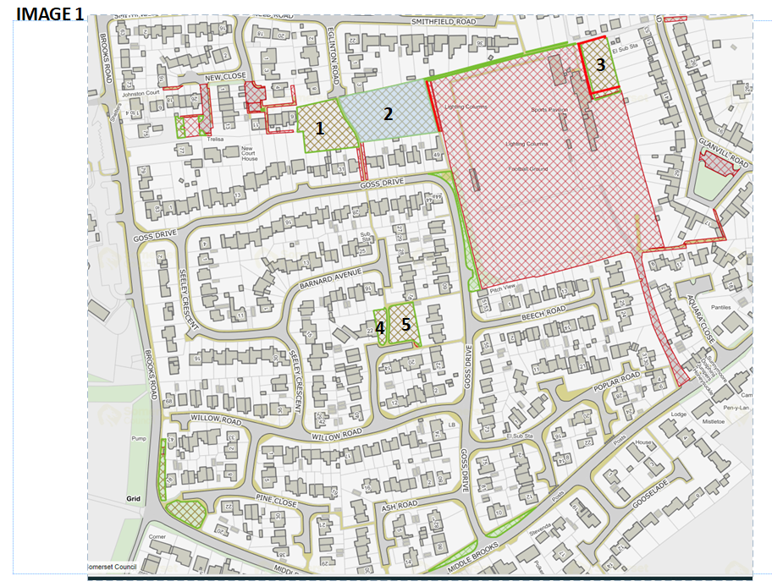
Goss Drive Play Area | 1
Goss Drive Grass Area | 2
Tannery Field Grass Area | 3
Willow Road Grass Area | 4&5

Slide 3
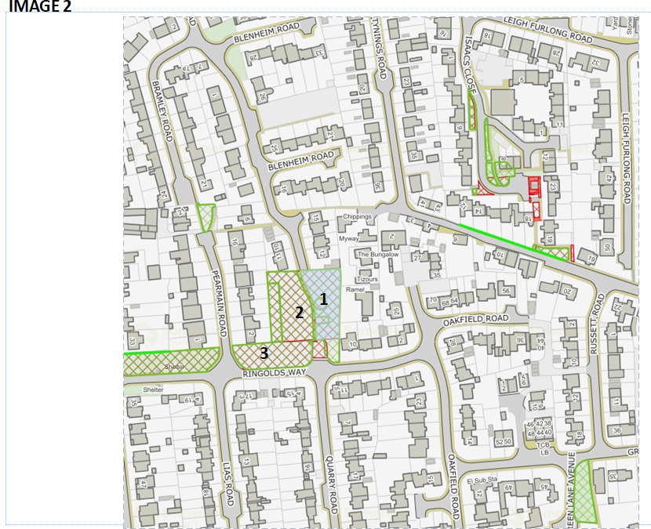
Ringolds Way Play Area | 1
Ringolds Way Grass Areas | 2&3

Slide 4
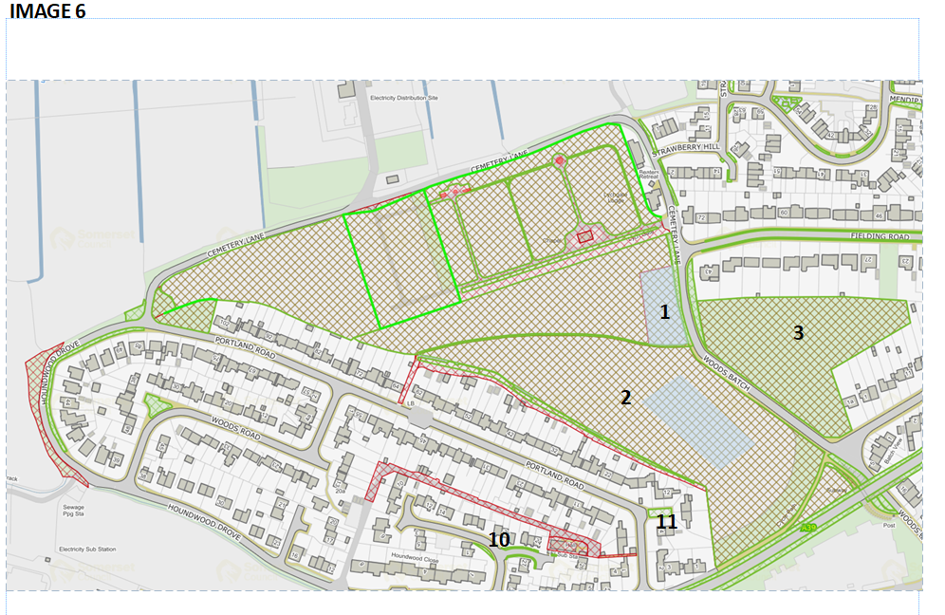
Take On the following
Woods Batch Play Area | 1

Slide 5
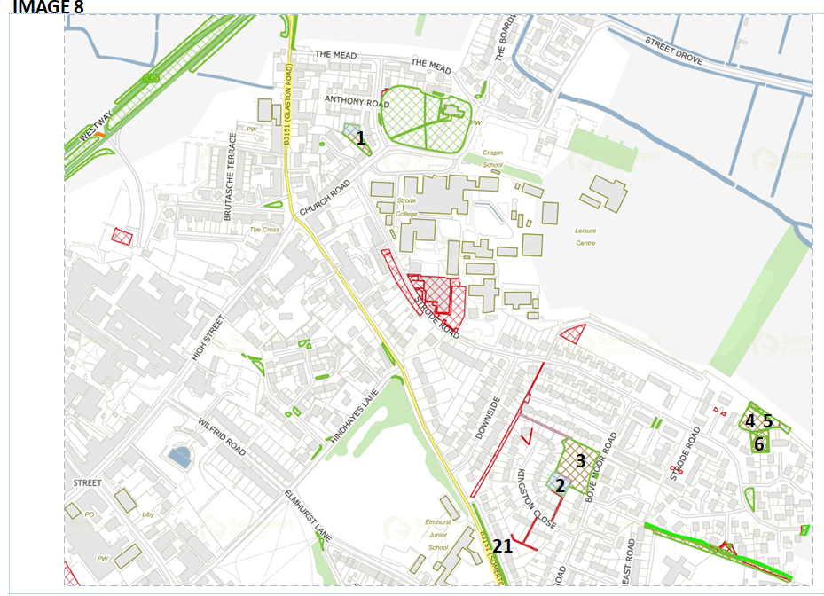
Bove Moor Road Play Area | 2
Bove Moor Road Grass Area | 3
Behind 173 Strode Road Grass | 4
Behind 179 Strode Road Grass | 5
Gould Close Grass Area | 6

Slide 6
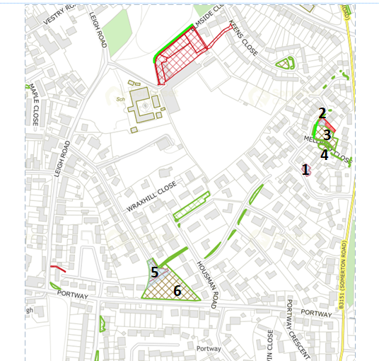
IMAGE 9
To be Advised
Mellanby Close Play Area Mellanby Close Grass Area Mellanby Close Grass Area | 2 3 4
Wraxhill Road Play Area | 5
Wraxhill Road Grass Area | 6

