Slide 1

[OFFICIAL]
Appendix 4
Standards Management
Guide for
Grounds Maintenance Contract

Slide 2
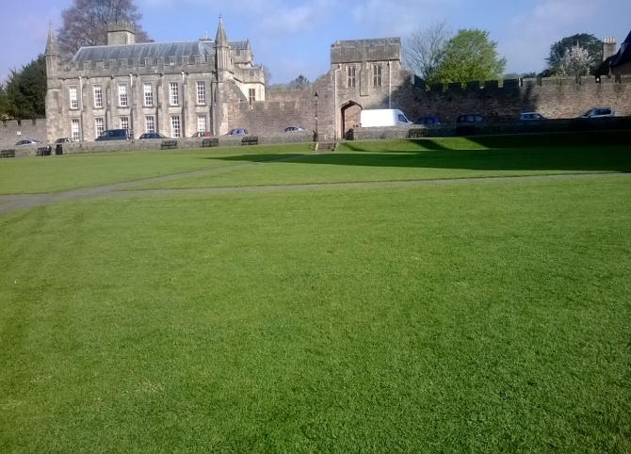
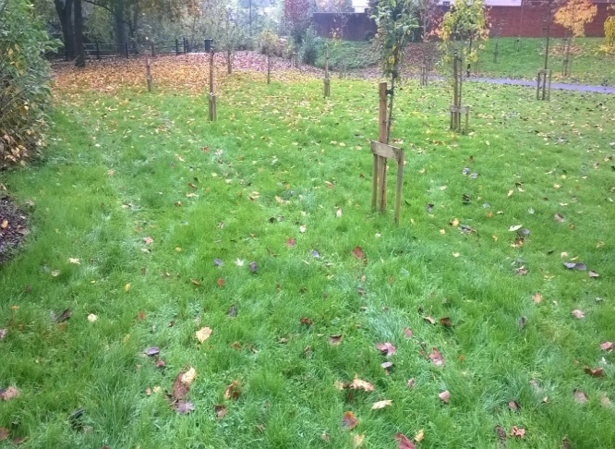
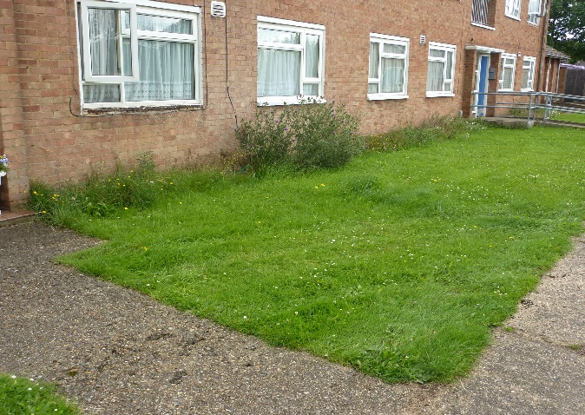
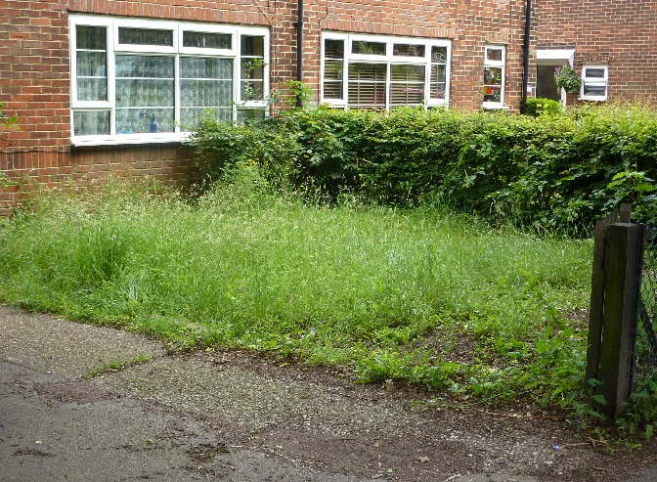
Grounds Maintenance (Grass Cutting)
[OFFICIAL]
A
B
C
Grass short, cut approx. every 14 days between March and October, with additional cuts instructed and carried out in high growth period and maintenance cuts over the winter (approx. monthly). Grass does not need to be picked up, strim as required but at least once a month to keep edges tidy, no arisings, back up work done to spec. No litter present, area looks to be a high standard.
Grass at end of 14-day period, arisings visible, minimal litter present
Grass tidy but back up
work not to spec. Litter present.
Grass overgrown, no back up works done.
Whole area out of spec.
A large amount of litter present
Standard Specification: Grass cutting and strimming should ensure no damage is caused to any play equipment, trees or fencing.
Grass cutting (approx. every 14 days between March and October – totalling 20 cuts).
Additional cuts as required during high growth period.
Maintenance cuts through the winter (approximately monthly).
Biodiversity Strategy – please note standards may vary where strategy for supporting biodiversity, e.g. longer grass at edges or mown paths
D
[OFFICIAL]

Slide 3
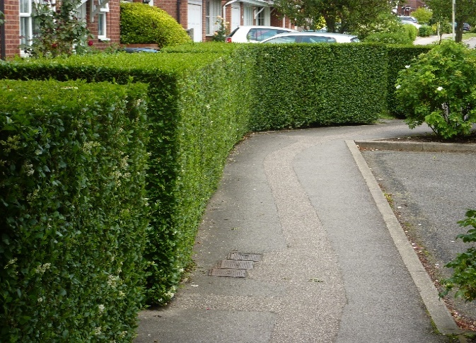
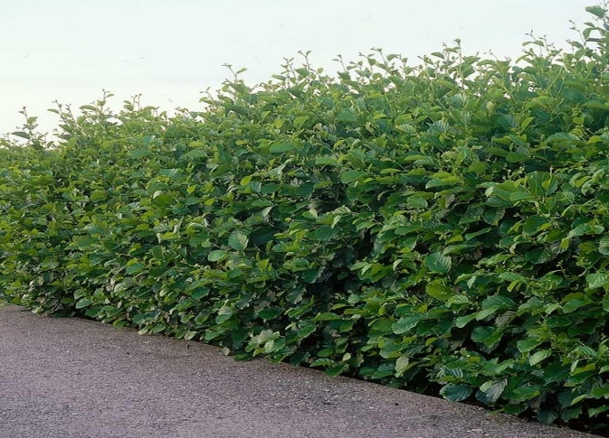
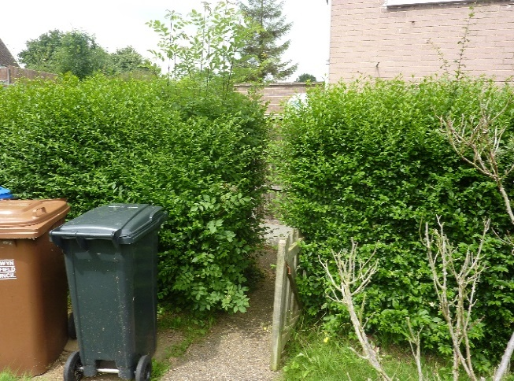
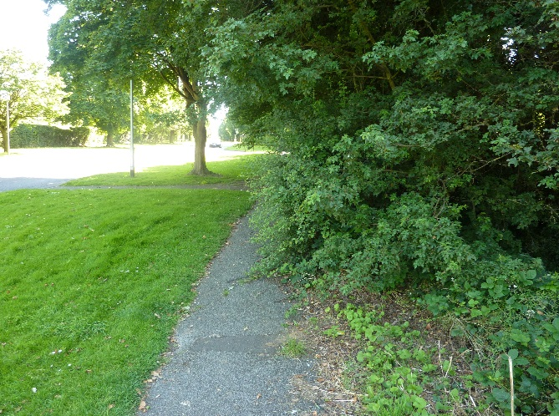
Grounds Maintenance (Hedges & Shrubs)
[OFFICIAL]
A
B
C
Hedge sides and top cut. Manicured appearance due to more cuts
Hedge still in spec, shows one year growth.
Hedge requiring work as overgrowing access/ pavement
D
Hedge out of spec, overgrowing footpath and more than a years growth
Standard Specification: Hedges close to a footpath or road clipped back. Clip lodgings in the top and side removed. Litter and debris removed from hedge base. Cut back to previous year's growth. Grade B picture shows growth hedge after and prior to being cut – both are of contract standard. Hedges and shrubs maintained 4 times per year. Please note the restrictions between 1st March – 31st August: https://www.gov.uk/guidance/countryside-hedgerows-regulation-and-management
[OFFICIAL]

Slide 4
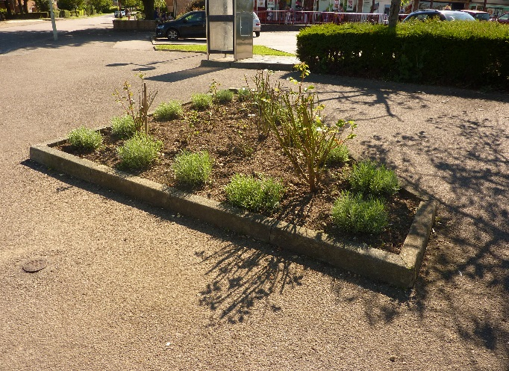
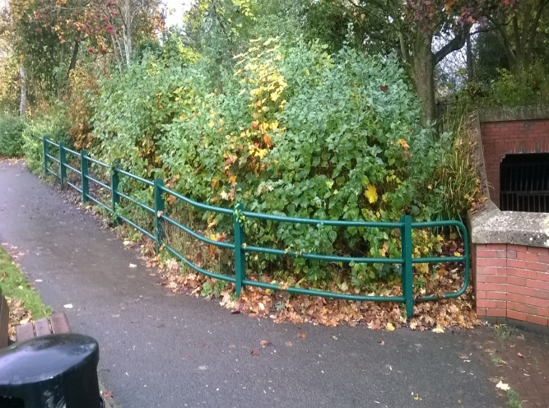
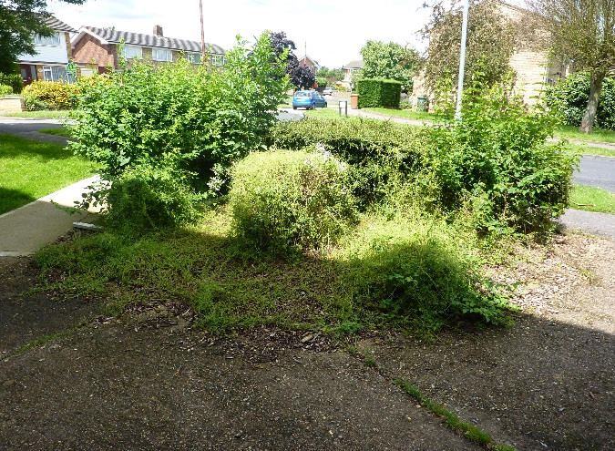
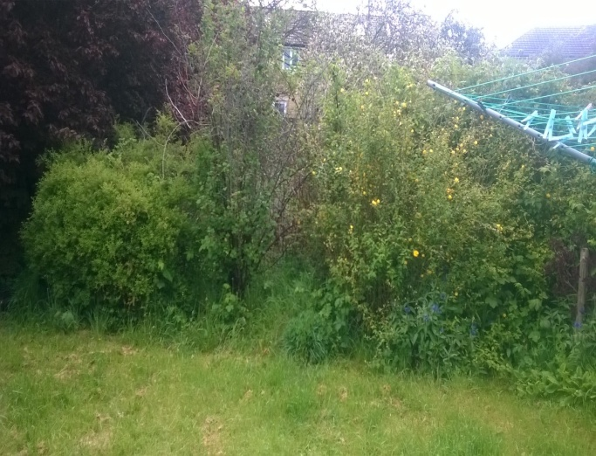
Grounds Maintenance (Amenity Planting)
[OFFICIAL]
A
B
C
Weed free, no litter and shrubs pruned. Area very tidy
Weed + litter minimal. One year growth. Not obstructing footpath
Weed growth, litter present. Shrubs obstructing footpath
D
Area totally overgrown with weeds/litter present
Standard Specification: Shrubs and flower beds free of litter, weeds, leaves and other extraneous material. Planned pruning to ensure shape is being maintained. Plants cut back from footpaths, roads and windows. Leaf removal Sweeping and removal of leaves as required to prevent blockage of drain etc Additional leaf removal may be required prior to any occasional event
[OFFICIAL]

Slide 5
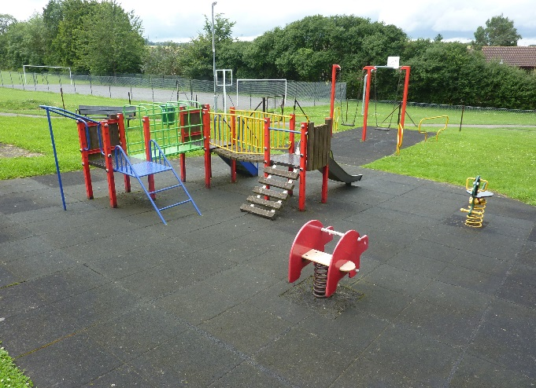
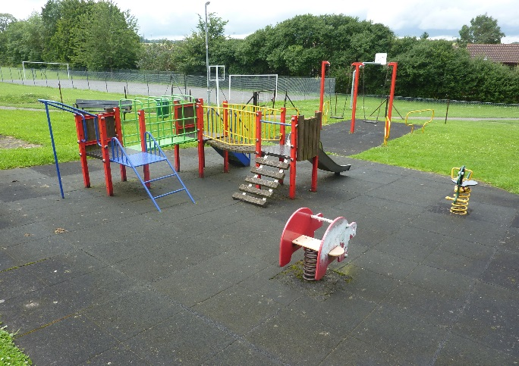
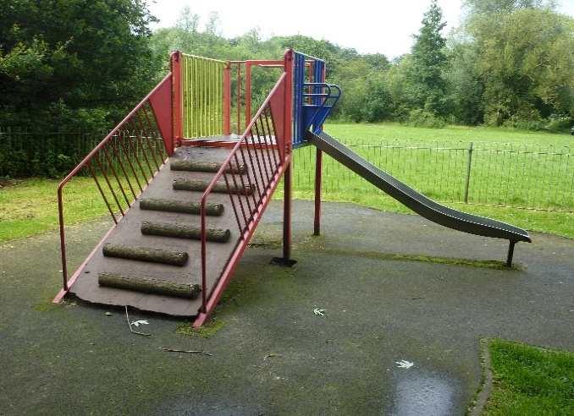
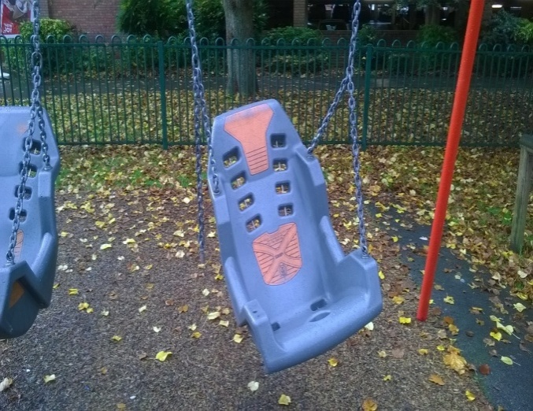
Sports and Play Areas
[OFFICIAL]
A
B
C
Area in good order, surface clean AND FREE FROM DEFECTS, free of moss, no litter or graffiti
Minor littering. No damage. Minor areas of moss present. Clean, some graffiti present.
Heavy moss on surface. Dirt and damage on play equipment visible.
D
Equipment unsafe. Surface damaged with littering and moss present.
General damage in play area
Specification: Clear of litter, debris, cigarette ends, chewing gum, fly-posting , dirt and moss. Clear of graffiti (within one working day). Play equipment kept in a clean and hygienic condition. Damaged play items made safe and secure.
[OFFICIAL]

Slide 6
Play Area Inspections
[OFFICIAL]
Specification: Weekly visual health and safety inspections of all play equipment including shelters. To include play equipment, signage, tables, seating, bins, gate operating properly, and play area fencing. Inspect play area ground for trip hazards including fox holes, rabbit holes, badger works or other animal damage. Make safe any damage or hazard. Provide photographs of any defective equipment as required to assist with the ordering of parts or assessing work. Quote for remedial works identified during visual inspections or as a result of the independent Annual Inspection. Report any matters requiring attention to Officers promptly following each inspection. Complete and return maintenance / safety inspection schedule on a weekly basis. Note: The Parish Council will arrange for an Annual Inspection of Play Areas. A report will identify works which need to be carried out immediately for reasons of safety as well as lower risk remedial works required. Specialist works identified in the report will be carried out by a specialist. Street Parish Council to supply contractor with a copy of the tree survey report.
[OFFICIAL]

Slide 7
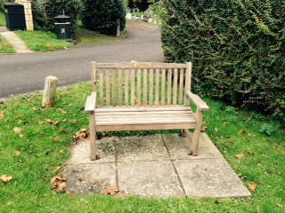
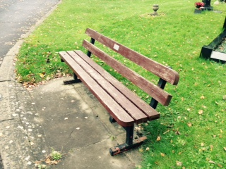
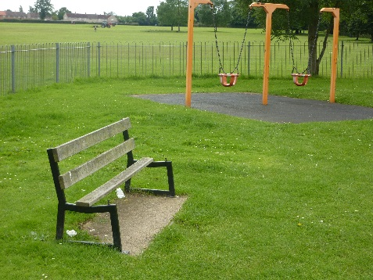
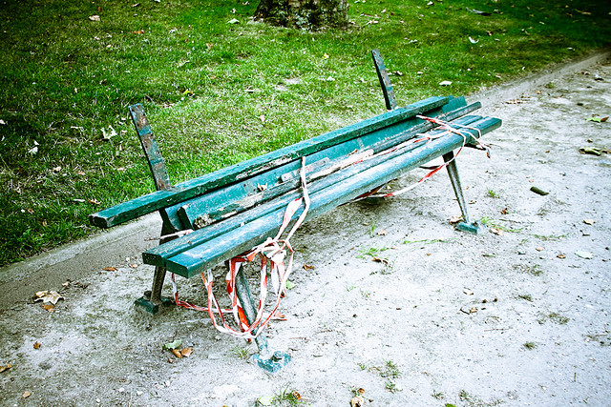
Asset Maintenance (Benches & Street Furniture)
[OFFICIAL]
A
B
C
Good overall condition. Clean with no damage, paint in good order
No damage, paint starting to look poor. Clean and tidy
Damage present. Poor condition overall. Made safe
D
Unsafe, vandalised. Very poor condition overall
Specification: Furniture clear from litter and debris. Furniture kept in a clean and hygienic condition. Defective furniture made safe and secure. Damaged and unsafe furniture reported. All seats to be cleaned throughout the year. Report defect or damage to Officers and make safe. Quote for any repairs or maintenance tasks as required.
D
[OFFICIAL]

Slide 8
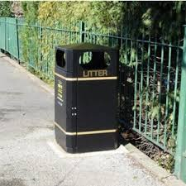
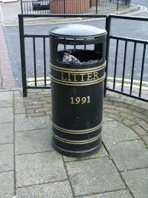
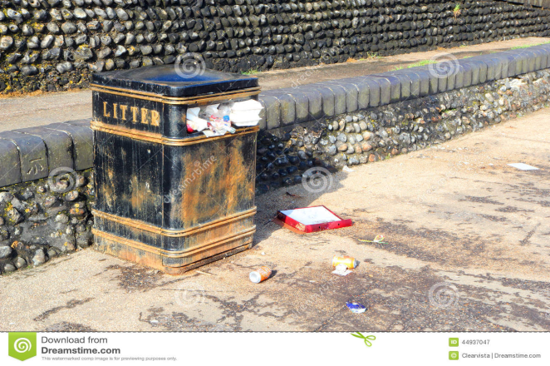
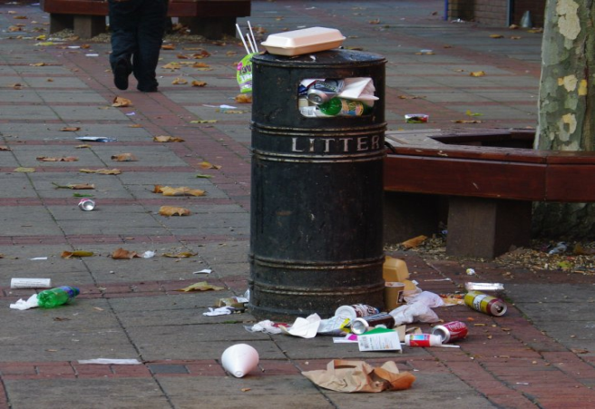
Litter Bins
[OFFICIAL]
A
B
C
Bins are unlikely to achieve above contract standard.
Bin has 25% capacity or more.
No damage , clean , no graffiti and area
around litter free
Bin overflowing , minimal litter on floor. Bin dirty/ damaged . Graffiti on bin
D
Specification
Bin overflowing on floor. Bin very dirty / damaged and covered in graffiti
All bins and liners shall be kept clean inside and out at all times and emptied regularly.
Any spillage or waste found adjacent to or close to the litter bin shall be cleaned up or cleared at the same time.
All standard bins shall have 25% available capacity at all times.
Any graffiti and fly posting present should also be removed.
Any defect or damage observed by the Service Provider whilst emptying bins shall be reported to the Council within two working days of damage or defect being first observed.
The Service Provider shall ensure that each litter and dog bin is thoroughly washed and disinfected internally and externally on a frequency not less than twice a year.
[OFFICIAL]

Slide 9
Tree Inspections
[OFFICIAL]
Standard Specification: Regular weekly visual health and safety inspections of trees. Report any tree issues to Officers. Quote for remedial works identified during checks or as part of the independent Annual Inspection that you are competent / qualified to carry out. Note: The Parish Council will arrange for an Annual Inspection of Trees. This report will identify works which need to be carried out immediately for reasons of safety to people or property or the short-term and long-term safe retention of trees. Specialist works identified in the report will be carried out by a specialist. Street Parish Council to supply contractor with a copy of the Tree Survey Report.
[OFFICIAL]

